Slide 1
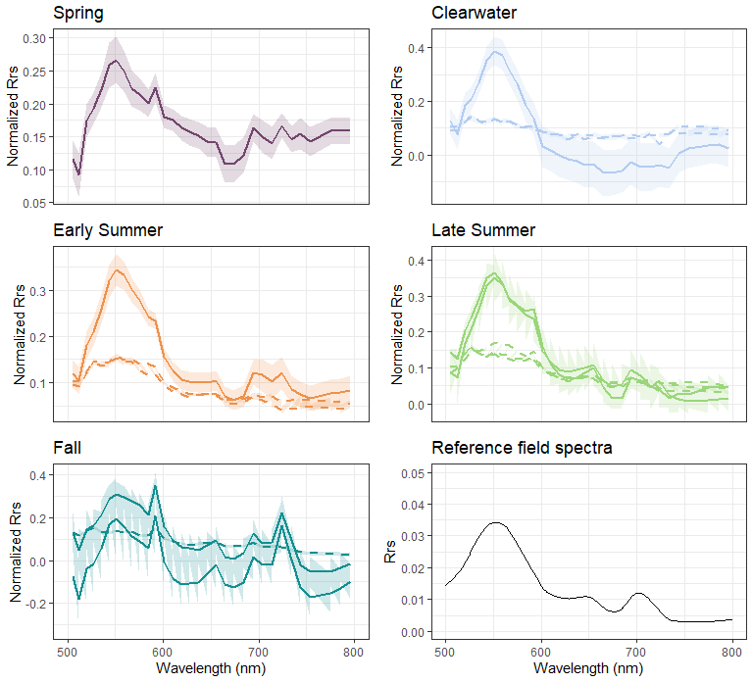
Suspended Solids
Chlorophyll a
Suspended Solids
Phycocyanin

